Slide 1

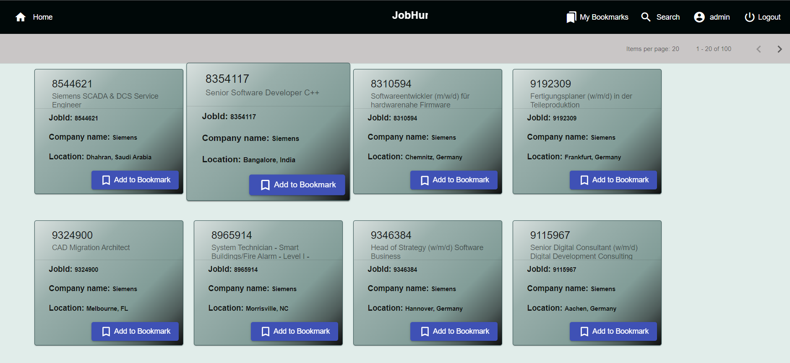

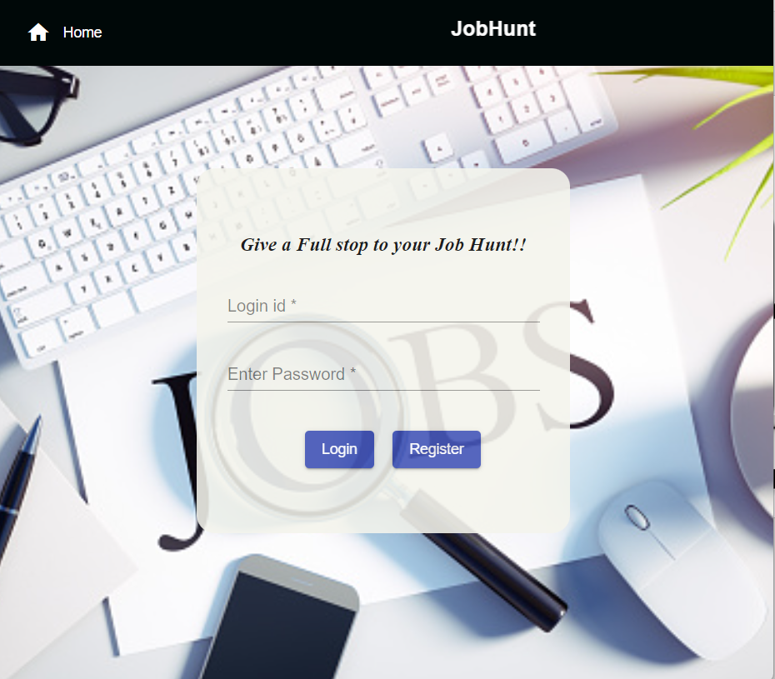
Job Hunt
Name: Mihir Patel

Slide 2
Outline
Problem Statement
Objective
Microservices
Project Overview
Architecture
Application Flow
Technology and Tools Used
Conclusion

Slide 3

Problem Statement
Home Page should consist of Register page link through which a user can register himself. Upon registration, the user able to login into his account.
A user can search for a job through online mode using an app after he gets logged in.
He can bookmark the jobs and add the status to the job

Slide 4
Objective
Main objective is to provide best user experience to X so that X can search and bookmark the jobs and add/modify status of particular job.

Slide 5
Microservices
Authentication API
API Gateway
Discovery service
(Eureka)
Watchlist API

Slide 6
Project Overview

Slide 7
Project Overview
Authentication API
Favourite API
Status
Favourite
Login
Home
Search
Register
SQL
Server
External API

Slide 8
Onboarding Architecture

Slide 9
Architecture
Login/ Register
Authentication API
JWT validator
POST request
Token generated
SQL Server
Front End
Angular
Api Gateway
GET/DELETE
Favourite API
Get favourite
Delete favourite
POST /GET/
DELETE

Slide 10
Project Flow

Slide 11
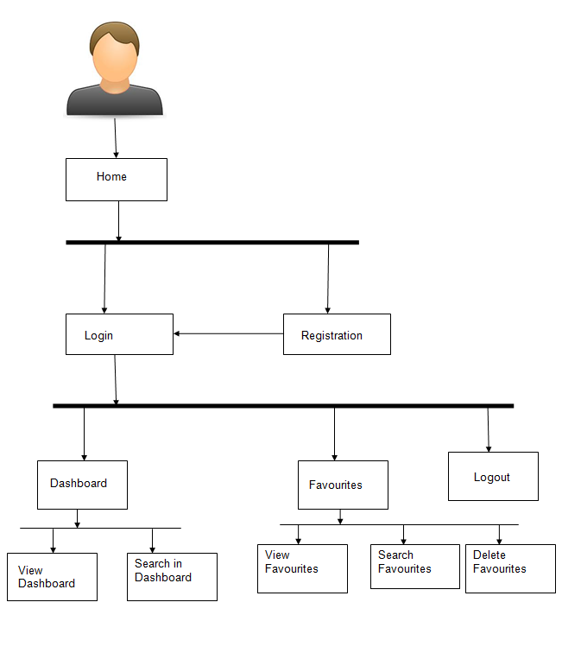
Project Flow
Home
Login
Register
Favourite
Recommends
Search
View Favourites
Delete Favourite
Add to Favourite
Search Books
Change the Status

Slide 12






Technologies and Tools Used

Slide 13
Conclusion
The Job-hunt app helps the user to search jobs online. It also helps user to store the best jobs in watchlist and update status according to his needs and delete them afterwards.

Slide 14
Thank You

Slide 15


